Slide 1

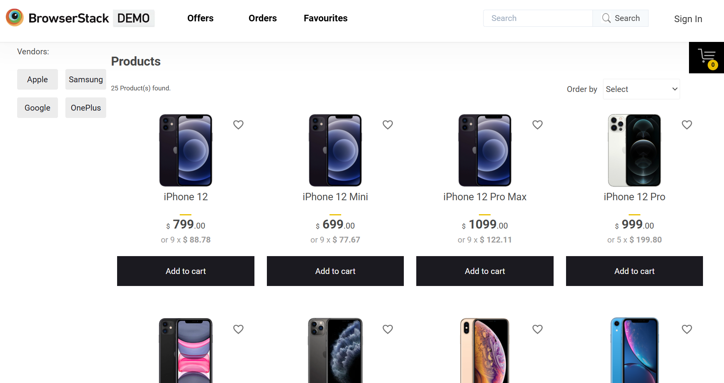
Browser Stack Demo Website Testing automation
GROUP E
Aryaman Pandey - 20695753
Ankur Nigam - 20695569
Shiva Raghavendra Kumar P - 20695763
Chanchal Bhangale - 20695935

Slide 2
INTRODUCTION This project focuses on automating the Browser Stack Demo Website, a sample e-commerce application that provides real-world functionalities such as user authentication, product browsing, filtering, cart management, checkout, and order confirmation. The objective of this project is to design and implement a scalable automation testing framework using Selenium WebDriver and Java that can validate critical business functionalities with minimal manual intervention. The framework is built following industry-standard practices such as the Page Object Model (POM), reusable utilities, structured test scenarios, reporting mechanisms, and version control integration. Through this project, the team aims to demonstrate how automation testing can improve software quality, reduce testing effort, and provide faster feedback during application development. Tools & Technologies Used : Cucumber & TestNG

Slide 3

Automation testing helps improve software quality by executing test cases faster, more accurately, and repeatedly with minimal manual effort. It reduces testing time, increases test coverage, and enables quicker feedback during application development.
Key Points
Reduces manual testing effort.
Increases test execution speed.
Improves accuracy and reliability.
Supports regression and repetitive testing.
Enables faster delivery of high-quality software.
Automation Need

Slide 4
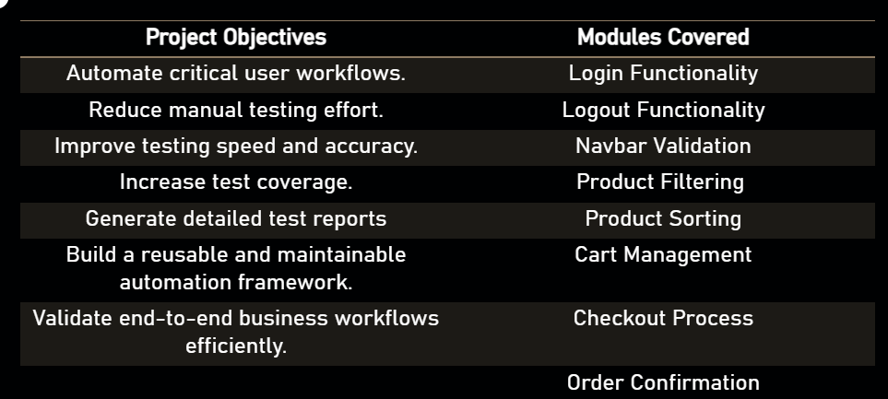

PROJECT OVERVIEW
The Browser Stack Demo Website Automation Project was developed to automate key user workflows and verify that major functionalities work as expected. The application includes features such as login, product filtering, cart management, checkout, and order confirmation, making it suitable for demonstrating real-world automation testing practices. The framework is designed using the Page Object Model (POM) approach to ensure better maintainability, scalability, and code reusability.
Expected Outcome : The Successful implementation of this automation framework enables faster regression testing, improved reliability, reduced testing effort, and better software quality assurance.

Slide 5
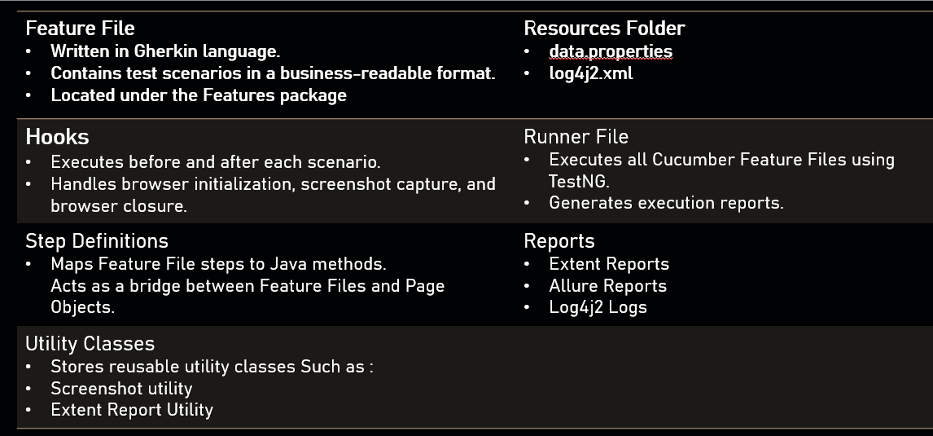
FRAMEWORK OVERVIEW
The BSTACKDEMO Automation Framework is developed using Selenium WebDriver, Cucumber BDD, TestNG, Page Object Model (POM), Maven, GitHub, and Jira. The framework is designed to provide a structured, maintainable, and scalable approach to test automation.

Slide 6
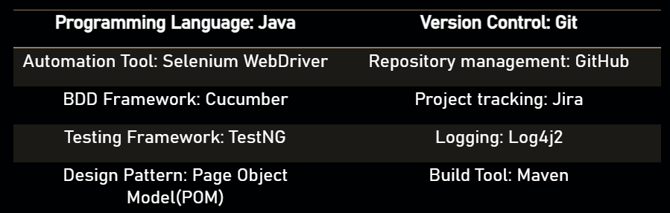
Tools & Technologies
The Browser Stack Demo Website Automation Framework is built using Java, Selenium WebDriver, Cucumber BDD, and TestNG to automate and validate web application functionality. Eclipse IDE and IntelliJ IDEA are used for development, while GitHub and Git support code management and collaboration. Jira is used for defect tracking, and Extent Reports and Allure Reports provide detailed test execution reports.
Application Under Test - Browser Stack Demo Website

Slide 7

Project Automation Flow
The Browser Stack Demo Website Automation Framework follows a structured workflow starting from feature creation to test execution and report generation. The framework uses Selenium WebDriver, Cucumber BDD, TestNG, and POM to ensure maintainable and efficient automation testing.
Key Points
Feature Files define test scenarios.
Hooks handle browser setup and teardown.
Step Definitions implement business logic.
POM manages page elements and actions.
Reports are generated using Extent and Allure.

Slide 8
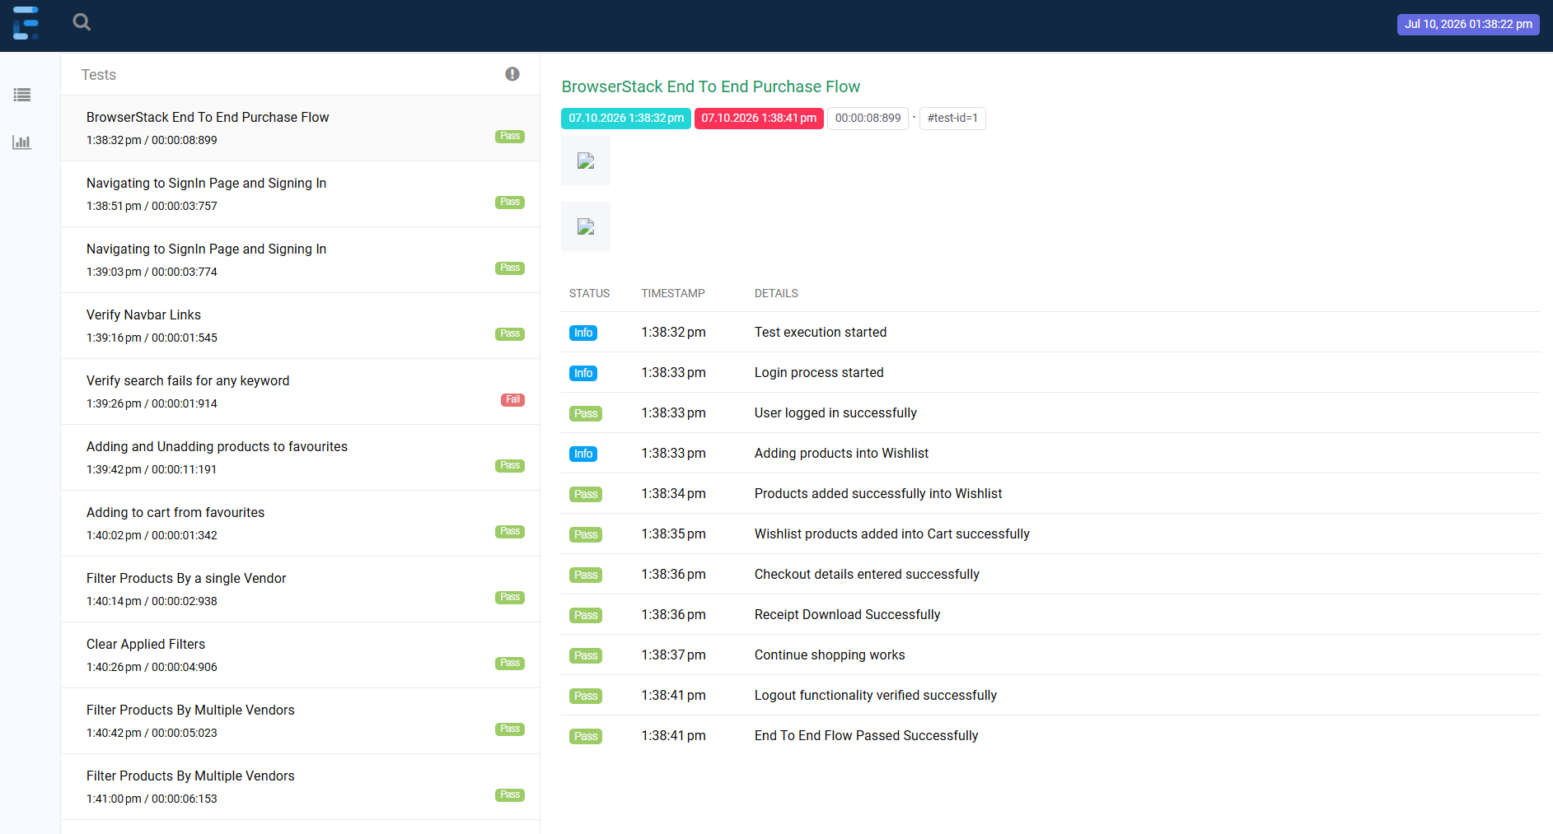
EXTENT REPORT

Slide 9
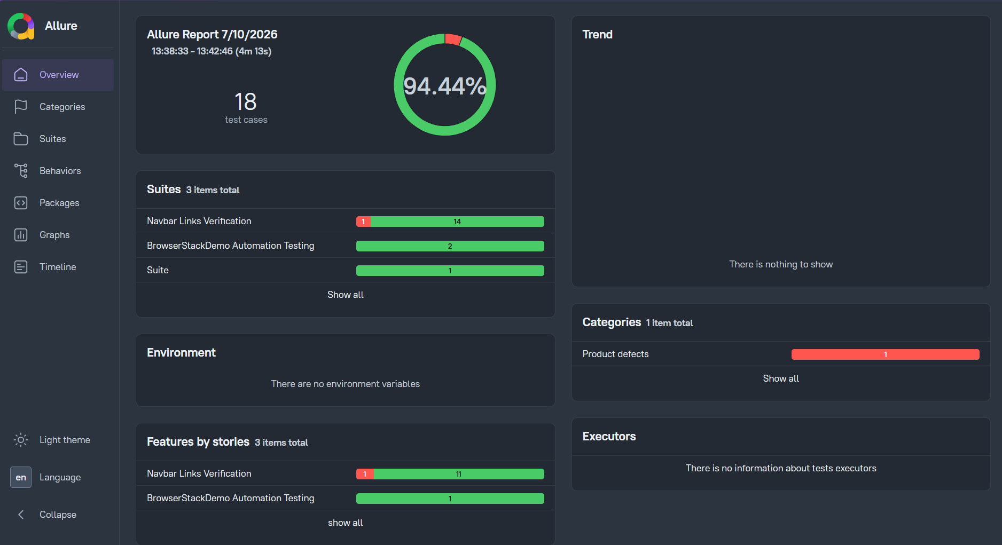
ALLURE REPORT

Slide 10
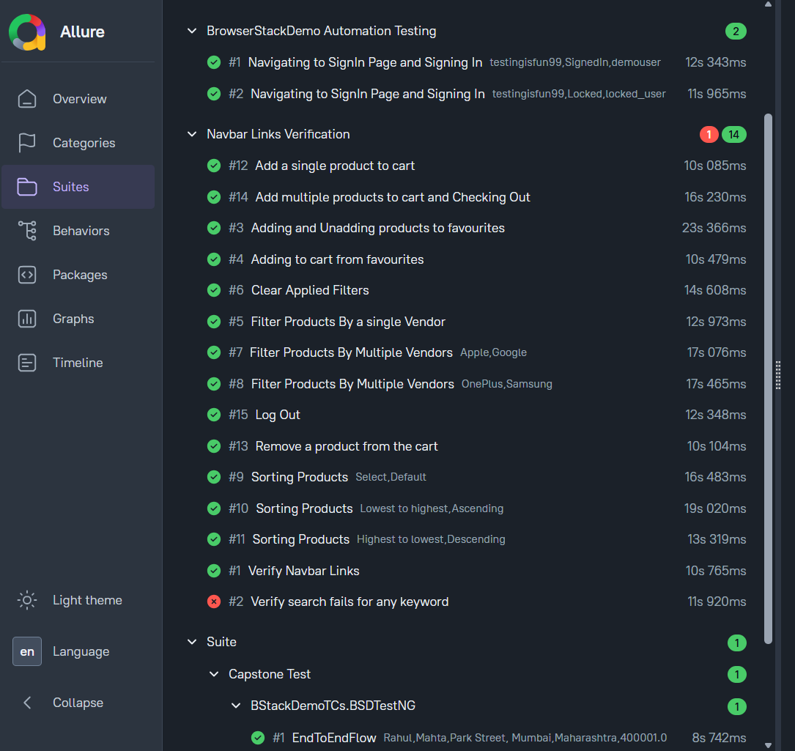
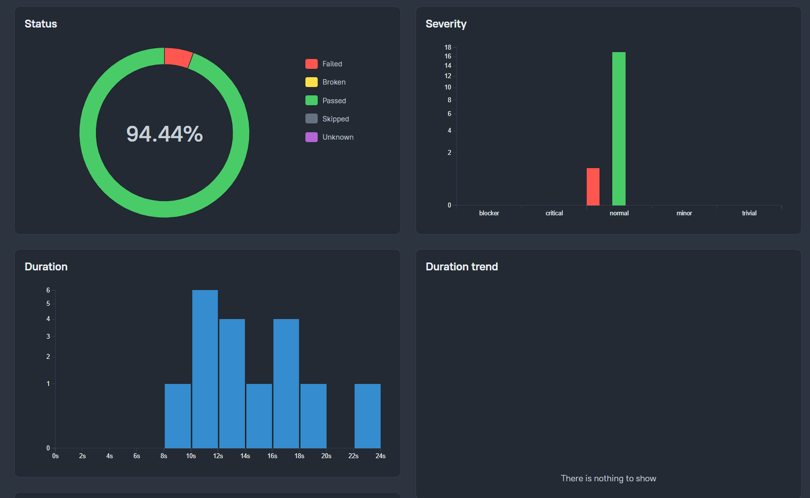

Slide 11
Git and Jira Strategy
Git and GitHub were used for source code management, enabling team members to work collaboratively through individual branches and merge requests. Jira was used to track project tasks, user stories, defects, and overall project progress throughout the development lifecycle.
Key Points
Git used for version control.
GitHub used as central code repository.
Separate branches for team development.
Jira used for task and bug tracking.
Code reviews performed before merging changes.

Slide 12
Challenges
During the project, several challenges were encountered related to framework integration, element handling, and report generation. These challenges provided valuable learning opportunities and helped improve problem-solving and debugging skills.
Key Points
Dynamic web element identification.
Synchronization and wait handling issues.
Framework integration and configuration.
Git merge conflict resolution.
Report and screenshot generation setup.

Slide 13
Conclusion
The Browser Stack Demo Website Automation Project successfully automated critical business functionalities using Selenium, Cucumber BDD, TestNG, and POM. The project enhanced understanding of automation framework development, team collaboration, version control, and test reporting while ensuring reliable application validation.
Key Points
Automated end-to-end user workflows.
Improved framework design skills.
Applied industry-standard tools and practices.
Enhanced collaboration using GitHub and Jira.
Delivered maintainable and scalable automation solution.

